Slide 1

Android 新技术趋势
陈亮亮 字节跳动 Android 工程师
Notes:
自我介绍

Slide 2

Android 新技术趋势
2021.7

Slide 3

目录
High-efficient development: Jetpack
Functional programming: Kotlin
Cross-platform framework: Flutter
Notes:
开源社区活跃，技术演进快，Google 主导
大家可以思考下：这三个新技术分别是为了解决什么问题

Slide 4

Jetpack
https://developer.android.com/jetpack/

Slide 5
Jetpack
Jetpack is a collection of Android software components to make it easier for you to develop great Android apps.
Notes:
不全是新的东西，多年演化和积累的结果

Slide 6
Jetpack
These components help you
Follow best practices
Eliminate boilerplate code
Build high quality, robust apps
Notes:
核心是提升效率

Slide 7

Foundation
AppCompat
Android KTX
Multidex
Test
Notes:
AppCompat:Android系统版本众多，为了使得低版本的系统可以使用新版Android的特性，引入了AppCompat
Android KTX：Kotlin扩展程序，可以更简洁的使用Android API
Multidex：DEX字节码文件内的代码可调用的引用总数超过65536时，会遇到一个构建错误
Test：方便开发者编写单元测试用例

Slide 8

Jetpack
Architecture
Data Binding
Lifecycles
LiveData
Navigation
Paging
Room
ViewModel
WorkManager
Notes:
Data Binding：可以使用声明性格式（而非程序化地）将布局中的界面组件绑定到应用中的数据源
Lifecycles：管理您的 Activity 和 Fragment 生命周期
LiveData：一种可观察的数据存储器类，与常规的可观察类不同，LiveData 具有生命周期感知能力
Navigation：可帮助您实现导航，无论是简单的按钮点击，还是应用栏和抽屉式导航栏等更为复杂的模式
Paging；分页加载框架
Room：数据库
ViewModel：以注重生命周期的方式管理界面相关的数据，经常和LiveData配合使用
WorkManager：管理后台任务

Slide 9

Jetpack
Behavior
Download manager
Media & playback
Notifications
Permissions
Preferences
Sharing
Slices
Notes:
Download manager：安排和管理大量下载任务
Media&playback：用于媒体播放和路由（包括 Google Cast）的向后兼容 API
通知：提供向后兼容的通知 API，支持 Wear 和 Auto
权限：用于检查和请求应用权限的兼容性 API
偏好设置：创建交互式设置屏幕
共享：提供适合应用操作栏的共享操作
切片：创建可在应用外部显示应用数据的灵活界面元素，切片属于界面模板，可在 Google 搜索应用内动态显示您应用中的丰富互动内容，之后还将在其他位置（如 Google 助理等）显示。

Slide 10

Jetpack
UI
Animation & transitions
Emoji
Fragment
Layout
Palette
Notes:
动画和过渡：移动微件和在屏幕之间过渡
表情符号：在旧版平台上启用最新的表情符号字体
Fragment：组件化界面的基本单位
布局：使用不同的容器做布局
调色板：从调色板中提取出有用的信息

Slide 11
Architecture
MVC
MVP
MVVM
Samples:
https://github.com/googlesamples/android-architecture

Slide 12
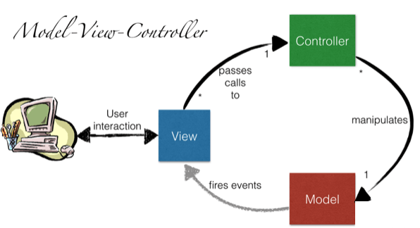
Architecture

Slide 13
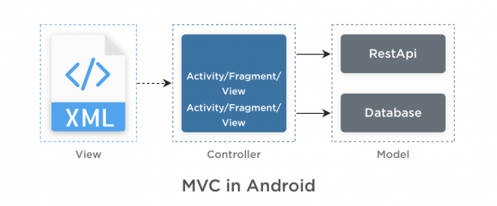
Architecture

Slide 14
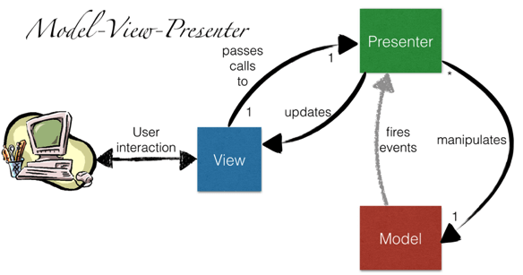
Architecture

Slide 15
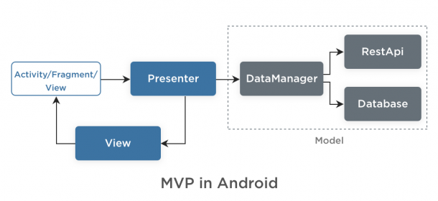
Architecture

Slide 16
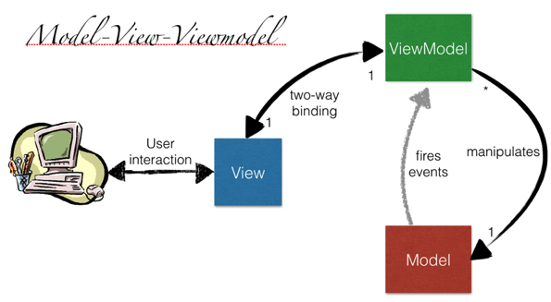
Architecture

Slide 17
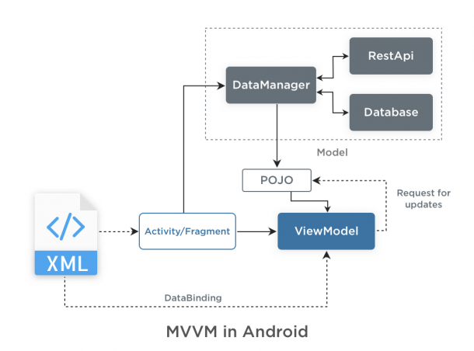
Architecture

Slide 18
LiveData

Slide 19
LiveData
Without LiveData
// ViewModel
List<User> userList;
List<UserLoadedListener> listeners = new ArrayList<>()
void registerListener(UserLoadedListener lsn) {
listeners.add(lsn)
}
void unregisterListener(UserLoadedListener lsn) {
listeners.remove(lsn)
}
void loadUsers() {
userService.getUsers(data -> {
userList = data;
// notify UI
for(UserLoadedListener lsn : listeners) {
lsn.onUserLoaded(userList);
}
})
}
// Activity
UserLoadedListener listener = data -> {
// update UI
}
// onCreate
userViewModel.registerListener(userListener);
userViewModel.loadUsers();
…
//onDestroy
userViewModel.unregisterListener(listener);

Slide 20
LiveData
With LiveData
// ViewModel
private MutableLiveData<List<User>> users;
public LiveData<List<User>> getUsers() {
if (users == null) {
users = new MutableLiveData<List<User>>();
userRepository.loadUsers(data -> {
userList.setValue(data);
})
}
return users;
}
// Activity
getUsers().observe(this, users -> {
// update UI
});

Slide 21
LiveData
Transformations
// map
LiveData<User> userLiveData = ...;
LiveData<String> userName = Transformations.map(userLiveData, user -> {
user.name + " " + user.lastName
});
// switchMap
private LiveData<User> getUser(String id) {
...;
}
LiveData<String> userId = ...;
LiveData<User> user = Transformations.switchMap(userId, id -> getUser(id) );

Slide 22
ViewModel

Slide 23
ViewModel
public class UserViewModel extends ViewModel {
private MutableLiveData<List<User>> users;
public LiveData<List<User>> getUsers() {
if (users == null) {
users = new MutableLiveData<List<User>>();
userRepository.loadUsers(data -> {
userList.setValue(data);
})
}
return users;
}
}

Slide 24
ViewModel
public class UserActivity extends AppCompatActivity {
@Override
public void onCreate(Bundle savedInstanceState) {
UserViewModel model = ViewModelProviders.of(this).get(UserViewModel.class);
model.getUsers().observe(this, users -> {
// update UI
});
}
}

Slide 25
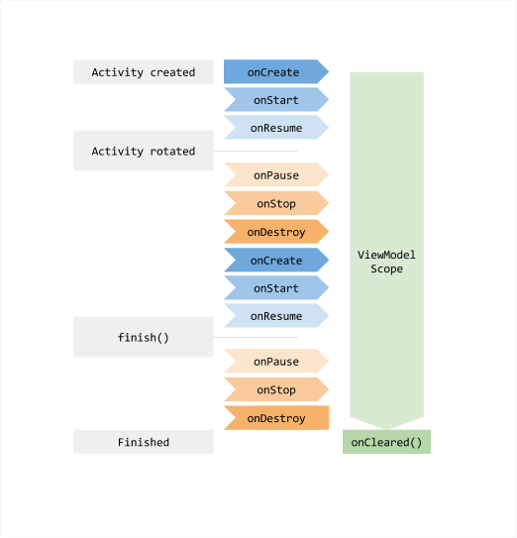
ViewModel

Slide 26
Lifecycles

Slide 27
Lifecycles
public class UserActivity extends AppCompatActivity {
@Override
public void onCreate(Bundle savedInstanceState) {
UserViewModel model = ViewModelProviders.of(this).get(UserViewModel.class);
model.getUsers().observe(this, users -> {
// update UI
});
}
}

Slide 28
Lifecycles
Fragments and Activities in Support Library 26.1.0 and later already implement the LifecycleOwner interface.
class AppCompatActivity extends Activity implements LifecycleOwner
class Fragment implements LifecycleOwner

Slide 29
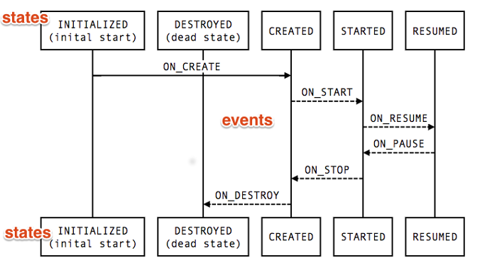
Lifecycles

Slide 30
Lifecycles
Activated

Slide 31
DataBinding

Slide 32
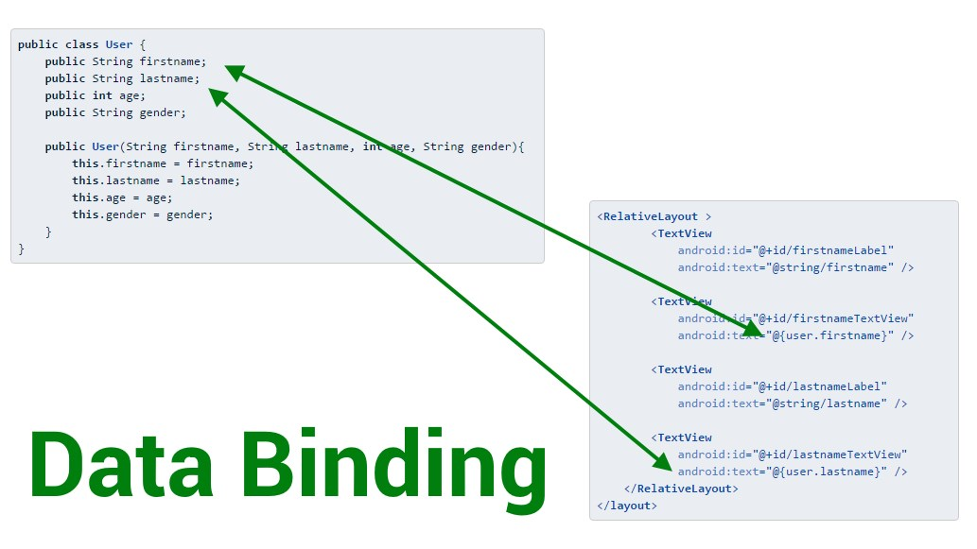
DataBinding

Slide 33
DataBinding
ViewModel
class UserModel extends ViewModel {
public final MutableLiveData<String> nickName = new MutableLiveData<>();
public final MutableLiveData<Integer> age = new MutableLiveData<>();
...
}

Slide 34
DataBinding
XML
<layout xmlns:android="http://schemas.android.com/apk/res/android">
<data>
<variable name="user" type="com.example.UserModel"/>
</data>
...
<TextView android:layout_width="wrap_content"
android:layout_height="wrap_content"
android:text="@{user.nickName}" />
...
</layout>

Slide 35
DataBinding
Activity
class UserActivity : AppCompatActivity() {
override fun onCreate(savedInstanceState: Bundle?) {
UserModel userModel = ViewModelProviders.of(getActivity()).get(UserModel.class)
val binding: UserBinding = DataBindingUtil.setContentView(this, R.layout.user)
binding.setLifecycleOwner(this)
binding.viewmodel = userModel
}
}

Slide 36
LiveData
LiveData
ViewModel
Lifecycles
Data Binding

Slide 37

Kotlin
https://kotlinlang.org/

Slide 38
Kotlin
A statically typed, cross-platform, general-purpose programming language with type inference.
Mainly targets the JVM, but also compiles to JavaScript or native code (via LLVM).
Sponsored by JetBrains, a software development company based in Prague, and is also backed by Google under the Kotlin Foundation.
Notes:
静态类型

Slide 39
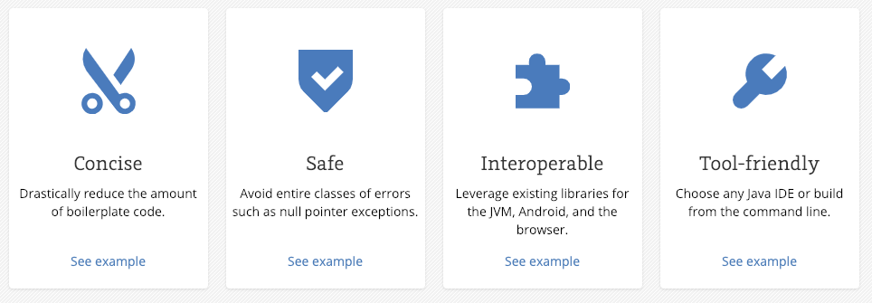
Why Kotlin
Notes:
简洁、安全、

Slide 40
Null Safety
// Java
void int getLastNameLength(User user) {
if (user != null
&& user.info != null
&& user.info.basicInfo != null
&& user.info.basicInfo.name != null
&& user.info.basicInfo.name.lastName != null) {
return user.info.basicInfo.name.lastName.length();
} else {
return -1;
}
}

Slide 41
Null Safety
// Java
void int getLastNameLength(User user) {
if (user != null
&& user.info != null
&& user.info.basicInfo != null
&& user.info.basicInfo.name != null
&& user.info.basicInfo.name.lastName != null) {
return user.info.basicInfo.name.lastName.length();
} else {
return -1;
}
}
// Kotlin
fun getLastNameLength(val user: User?)
= user?.info?.basicInfo?.name?.lastName?.length() ?: -1

Slide 42
Default Arguments
// Java
class View {
public View(Context context) { … }
public View(Context context, @Nullable AttributeSet attrs) {
this(context, attrs, 0);
}
public View(Context context, @Nullable AttributeSet attrs,
int defStyleAttr) {
this(context, attrs, defStyleAttr, 0);
}
public View(Context context, @Nullable AttributeSet attrs,
int defStyleAttr, int defStyleRes) {
this(context);
...
}
}

Slide 43
Default Arguments
// Java
class View {
public View(Context context) { … }
public View(Context context, @Nullable AttributeSet attrs) {
this(context, attrs, 0);
}
public View(Context context, @Nullable AttributeSet attrs,
int defStyleAttr) {
this(context, attrs, defStyleAttr, 0);
}
public View(Context context, @Nullable AttributeSet attrs,
int defStyleAttr, int defStyleRes) {
this(context);
...
}
}
// Kotlin
class View(context: Context, attrs: AttributeSet? = null, defStyleAttr: Int = 0,
defStyleRes: Int = 0)

Slide 44
Lazy Initiation
// Java
private MediaPlayer mPlayer;
public synchronized void play(String url) {
if (mPlayer == null) {
mPlayer = createPlayer();
}
mPlayer.play(url);
}

Slide 45
Lazy Initiation
// Java
private MediaPlayer mPlayer;
public synchronized void play(String url) {
if (mPlayer == null) {
mPlayer = createPlayer();
}
mPlayer.play(url);
}
// Kotlin
private val mPlayer: MediaPlayer by lazy {
createPlayer()
}
fun play(val url: String) {
mPlayer.play(url)
}

Slide 46
Data class
// Java
class User {
public final String firstName;
public final String lastName;
public final int age;
public final String avatarUrl;
public final List<User> friends;
public User(String firstName, String lastName,
int age, List<User> friends) {
this.firstName = firstName;
this.lastName = lastName;
this.age = age;
this.avatarUrl = avatarUrl;
this.friends = friends;
}
}

Slide 47
Data class
// Java
class User {
public final String firstName;
public final String lastName;
public final int age;
public final String avatarUrl;
public final List<User> friends;
public User(String firstName, String lastName,
int age, List<User> friends) {
this.firstName = firstName;
this.lastName = lastName;
this.age = age;
this.avatarUrl = avatarUrl;
this.friends = friends;
}
}
// Kotlin
data class User(val firstName: String, val lastName: String,
val age: Int, val avatarUrl: String, val List<User> friends)

Slide 48
Data class
// Java
User mUser;
…
void onAvatarUpdated(String newAvatarUrl) {
List<User> friends = new ArrayList<>();
for (User user : mUser.friends) {
friends.add(user);
}
mUser = new User(mUser.firstName, mUser.lastName,
mUser.age, newAvatarUrl, friends)
}

Slide 49
Data class
// Java
User mUser;
…
void onAvatarUpdated(String newAvatarUrl) {
List<User> friends = new ArrayList<>();
for (User user : mUser.friends) {
friends.add(user);
}
mUser = new User(mUser.firstName, mUser.lastName,
mUser.age, newAvatarUrl, friends)
}
// Kotlin
var mUser
newAvartarUrl -> {
mUser = mUser.copy(avatarUrl = newAvatarUrl)
}

Slide 50
Extension Functions
// Java
public class SwapableArrayList<T> extends ArrayList<T> {
public void swap(int index1, int index2) {
T temp = get(index1);
set(index1, get(index2));
set(index2, temp);
}
}

Slide 51
Extension Functions
// Java
public class SwapableArrayList<T> extends ArrayList<T> {
public void swap(int index1, int index2) {
T temp = get(index1);
set(index1, get(index2));
set(index2, temp);
}
}
// Kotlin
fun MutableList<Int>.swap(index1: Int, index2: Int) {
val tmp = this[index1]
this[index1] = this[index2]
this[index2] = tmp
}

Slide 52
Extension Properties
// Java
public class LastIndexArrayList<T> extends ArrayList<T> {
public void getLastIndex() {
return getSize() - 1;
}
}

Slide 53
Extension Properties
// Java
public class LastIndexArrayList<T> extends ArrayList<T> {
public void getLastIndex() {
return getSize() - 1;
}
}
// Kotlin
val <T> List<T>.lastIndex: Int
get() = size - 1

Slide 54
Extension Properties
// Java
public class LastIndexArrayList<T> extends SwapableArrayList<T> {
public void getLastIndex() {
return getSize() - 1;
}
}
// Kotlin
val <T> List<T>.lastIndex: Int
get() = size - 1

Slide 55
When Expression
// Kotlin
when (x) {
1 -> print("x == 1")
2 -> print("x == 2")
else -> { // Note the block
print("x is neither 1 nor 2")
}
}

Slide 56
When Expression
// Kotlin
when (x) {
1 -> print("x == 1")
2 -> print("x == 2")
else -> { // Note the block
print("x is neither 1 nor 2")
}
}
// Java
switch(x) {
case 1:
print("x == 1");
break;
case 2:
print("x == 2");
break;
default:
print("x is neither 1 nor 2");
break;
}

Slide 57
When Expression
// Kotlin
when (x) {
in 1..10 -> print("x is in the range")
in validNumbers -> print("x is valid")
!in 10..20 -> print("x is outside the range")
else -> print("none of the above")
}

Slide 58

When Expression
// Kotlin
when (x) {
in 1..10 -> print("x is in the range")
in validNumbers -> print("x is valid")
!in 10..20 -> print("x is outside the range")
else -> print("none of the above")
}
// Java

Slide 59
Functional Programming
Kotlin functions are first-class, which means that they can be stored in variables and data structures, passed as arguments to and returned from other higher-order functions.

Slide 60
Functional Programming
// OOP
class Calculator {
double plus(int a, int b) { return a + b; }
double minus(int a, int b) { return a - b; }
double multiply(int a, int b) { return a * b; }
double divide(int a, int b) { return a / b; }
...
}

Slide 61
Functional Programming
// OOP
class Calculator {
double plus(int a, int b) { return a + b; }
double minus(int a, int b) { return a - b; }
double multiply(int a, int b) { return a * b; }
double divide(int a, int b) { return a / b; }
...
}
// FP
typealias Operator = (Double, Double) -> Double
val plus: Operator = { a, b -> a + b}
val minus: Operator = { a, b -> a - b}
val multiply: Operator = { a, b -> a * b}
val divide: Operator = { a, b -> a / b}
fun operate(val a: Double, val b: Double, operator: Operator)
= operator(a, b)
val sum = operate(4, 6, cal.plus)

Slide 62
Functional Programming
fun <T, R> Collection<T>.fold(
initial: R,
combine: (acc: R, nextElement: T) -> R
): R {
var accumulator: R = initial
for (element: T in this) {
accumulator = combine(accumulator, element)
}
return accumulator
}
val items = listOf(1, 2, 3, 4, 5)
// sum
items.fold(0, {
acc: Int, i: Int ->
val result = acc + i
})
// multiply
val product = items.fold(1, Int::times)
// joined to string
val joinedToString = items.fold("Elements:", { acc, i -> acc + " " + i })

Slide 63
KTX
// Kotlin
sharedPreferences.edit()
.putBoolean("key", value)
.apply()
db.beginTransaction()
try {
// insert data
db.setTransactionSuccessful()
} finally {
db.endTransaction()
}
// Kotlin + KTX
sharedPreferences.edit {
putBoolean("key", value)
}
db.transaction {
// insert data
}

Slide 64



Cross-Platform

Slide 65

PhoneGap

Slide 66
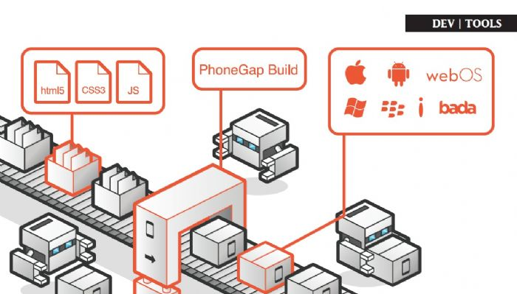
PhoneGap

Slide 67
PhoneGap
Poor Performance
Lack Of UI Widgets
No complete support to the features of an OS

Slide 68

ReactNative

Slide 69
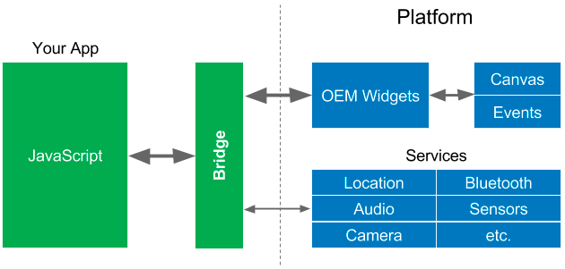
ReactNative

Slide 70
ReactNative
Poor Compatibility
Lack Security Robustness
Poor Memory Management

Slide 71


Slide 72
Flutter
https://flutter.io/

Slide 73
Flutter
Flutter allows you to build beautiful native apps on iOS and Android from a single codebase.

Slide 74
Dart
class MyApp extends StatelessWidget { @override Widget build(BuildContext context) { return Container( decoration: BoxDecoration(color: Colors.white), child: Center( child: Text( 'Hello World', textDirection: TextDirection.ltr, style: TextStyle( fontSize: 32.0, color: Colors.black87, ), ), ), ); } }

Slide 75
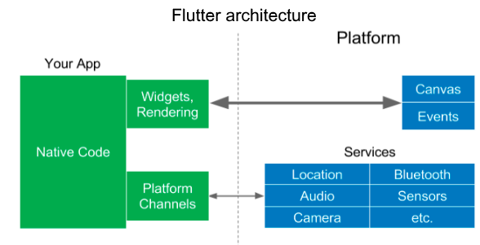
Flutter

Slide 76
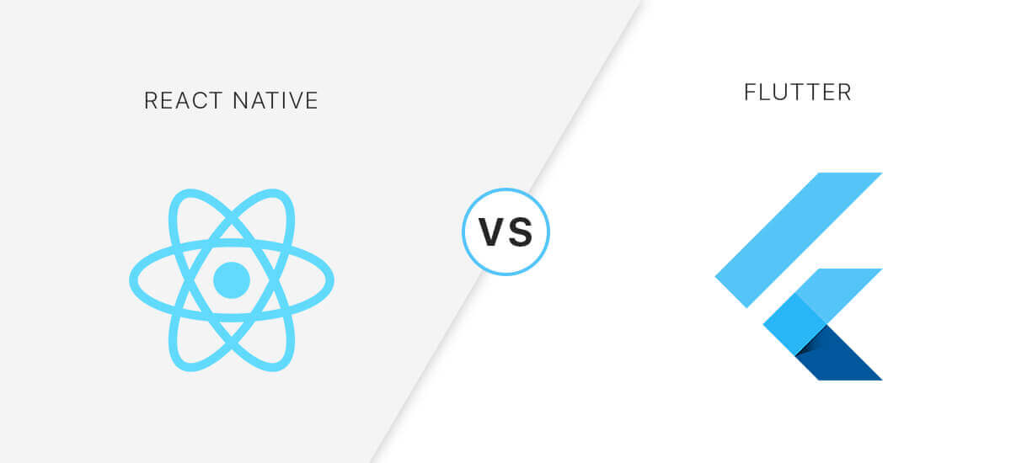

Slide 77
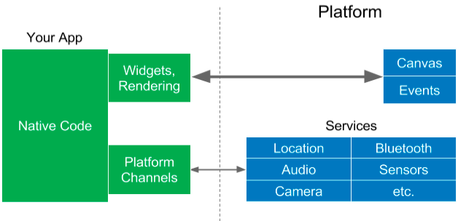
Flutter
Notes:
RN：由于JavaScript领域访问Native领域的OEM widgets，因此它也必须通过这个桥梁。 通常访问widgets的频率非常高（在动画，转换过程中，或者用户用手指在屏幕上滑动某些东西时，每秒可达60次），因此可能会导致性能问题
Flutter：Flutter可以与平台进行通信，而无需通过执行了上下文切换的JavaScript Bridge

Slide 78
Flutter
Fast Development
Expressive and Flexible UI
Native Performance

Slide 79
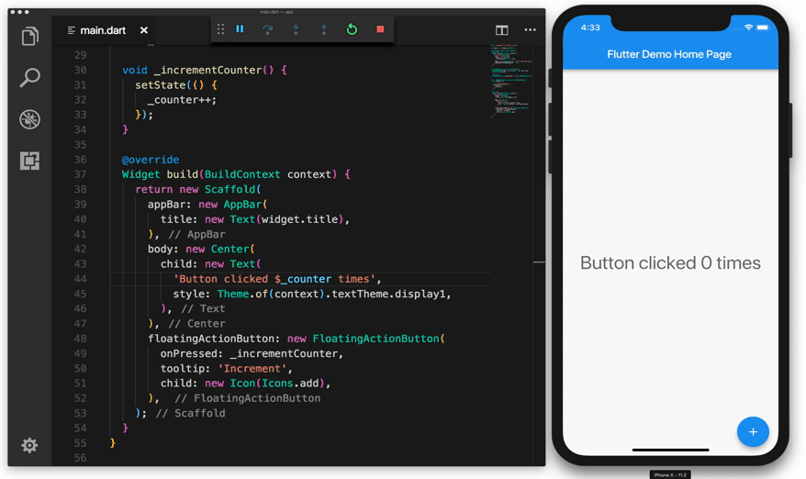
Hot Reload

Slide 80
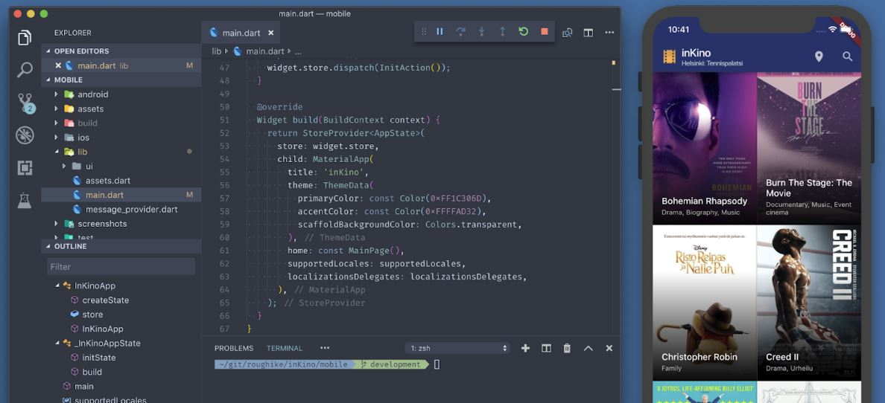
Flexible UI

Slide 81
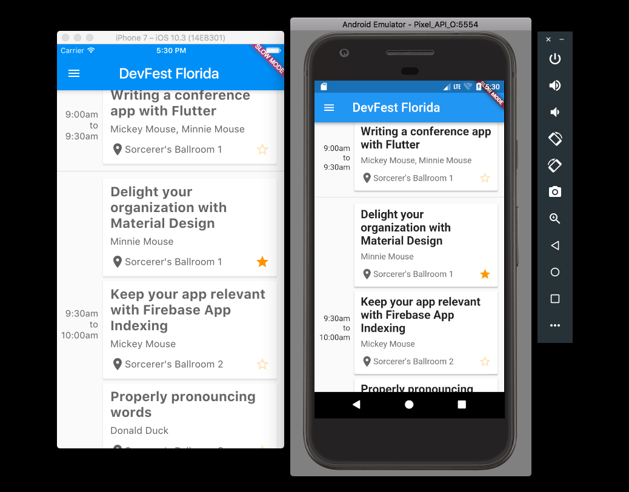
Cross-Platform

Slide 82

THANKS.

